Slide 1

Qiskit Advocate Mentorship Program
Eraraya Ricardo Muten
Engineering Physics Undergraduate, Quantum Tech. Lab Bandung Institute of Technology
Mentor: Anna Phan Research Scientist at IBM Quantum
Project: #43 QML Qiskit Implementations

Slide 2
Project Description
Implement the “Data re-uploading for a universal quantum classifier” paper by Pérez-Salinas et al.[1] in Qiskit to classify PCA-reduced MNIST Dataset[2]. Write a blog post showing the code and explaining the difference between Qiskit implementation and other platform (PennyLane) implementation.
Implement “Quantum Graph Neural Networks” paper by Verdon et al.[3] in Qiskit. The notebook will be written as a Qiskit Textbook entry for the section 4.2.
[1] Pérez-Salinas A, Cervera-Lierta A, Gil-Fuster E, Latorre JI. Data reuploading for a universal quantum classifier. Quantum 2020;4:226. https://doi.org/10.22331/q-2020-02-06-226. [2] LeCun Y, Cortes C. MNIST handwritten digit database 2010. [3] Verdon G, McCourt T, Luzhnica E, Singh V, Leichenauer S, Hidary J. Quantum Graph Neural Networks. ArXiv 2019.

Slide 3
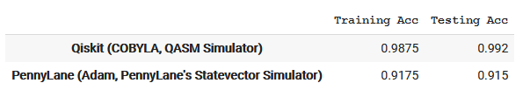
Progress
The final notebook for project number 1 is finished. As expected, we obtained similar training and testing accuracy compared to the PennyLane implementation. For binary classification (0 vs 1) we obtained: The difference comes from the different optimizers, hyperparameters (e.g., max iter: 10 Adam iteration with 13 batches/iteration for PennyLane and 1000 COBYLA iteration for Qiskit) and backends used.
The notebook can be accessed here (GitHub repo): http://bit.ly/Qiskit-Mentorship

Slide 4
Next Target
Write the blog post (Medium?) for project number 1. Anyone has suggestions on what platform to be used for the blogpost? Is it better to write it in the Qiskit’s Medium or personal Medium?
Start to read the reference [3] paper comprehensively.
Write a temporary notebook for project number 2.

Slide 5
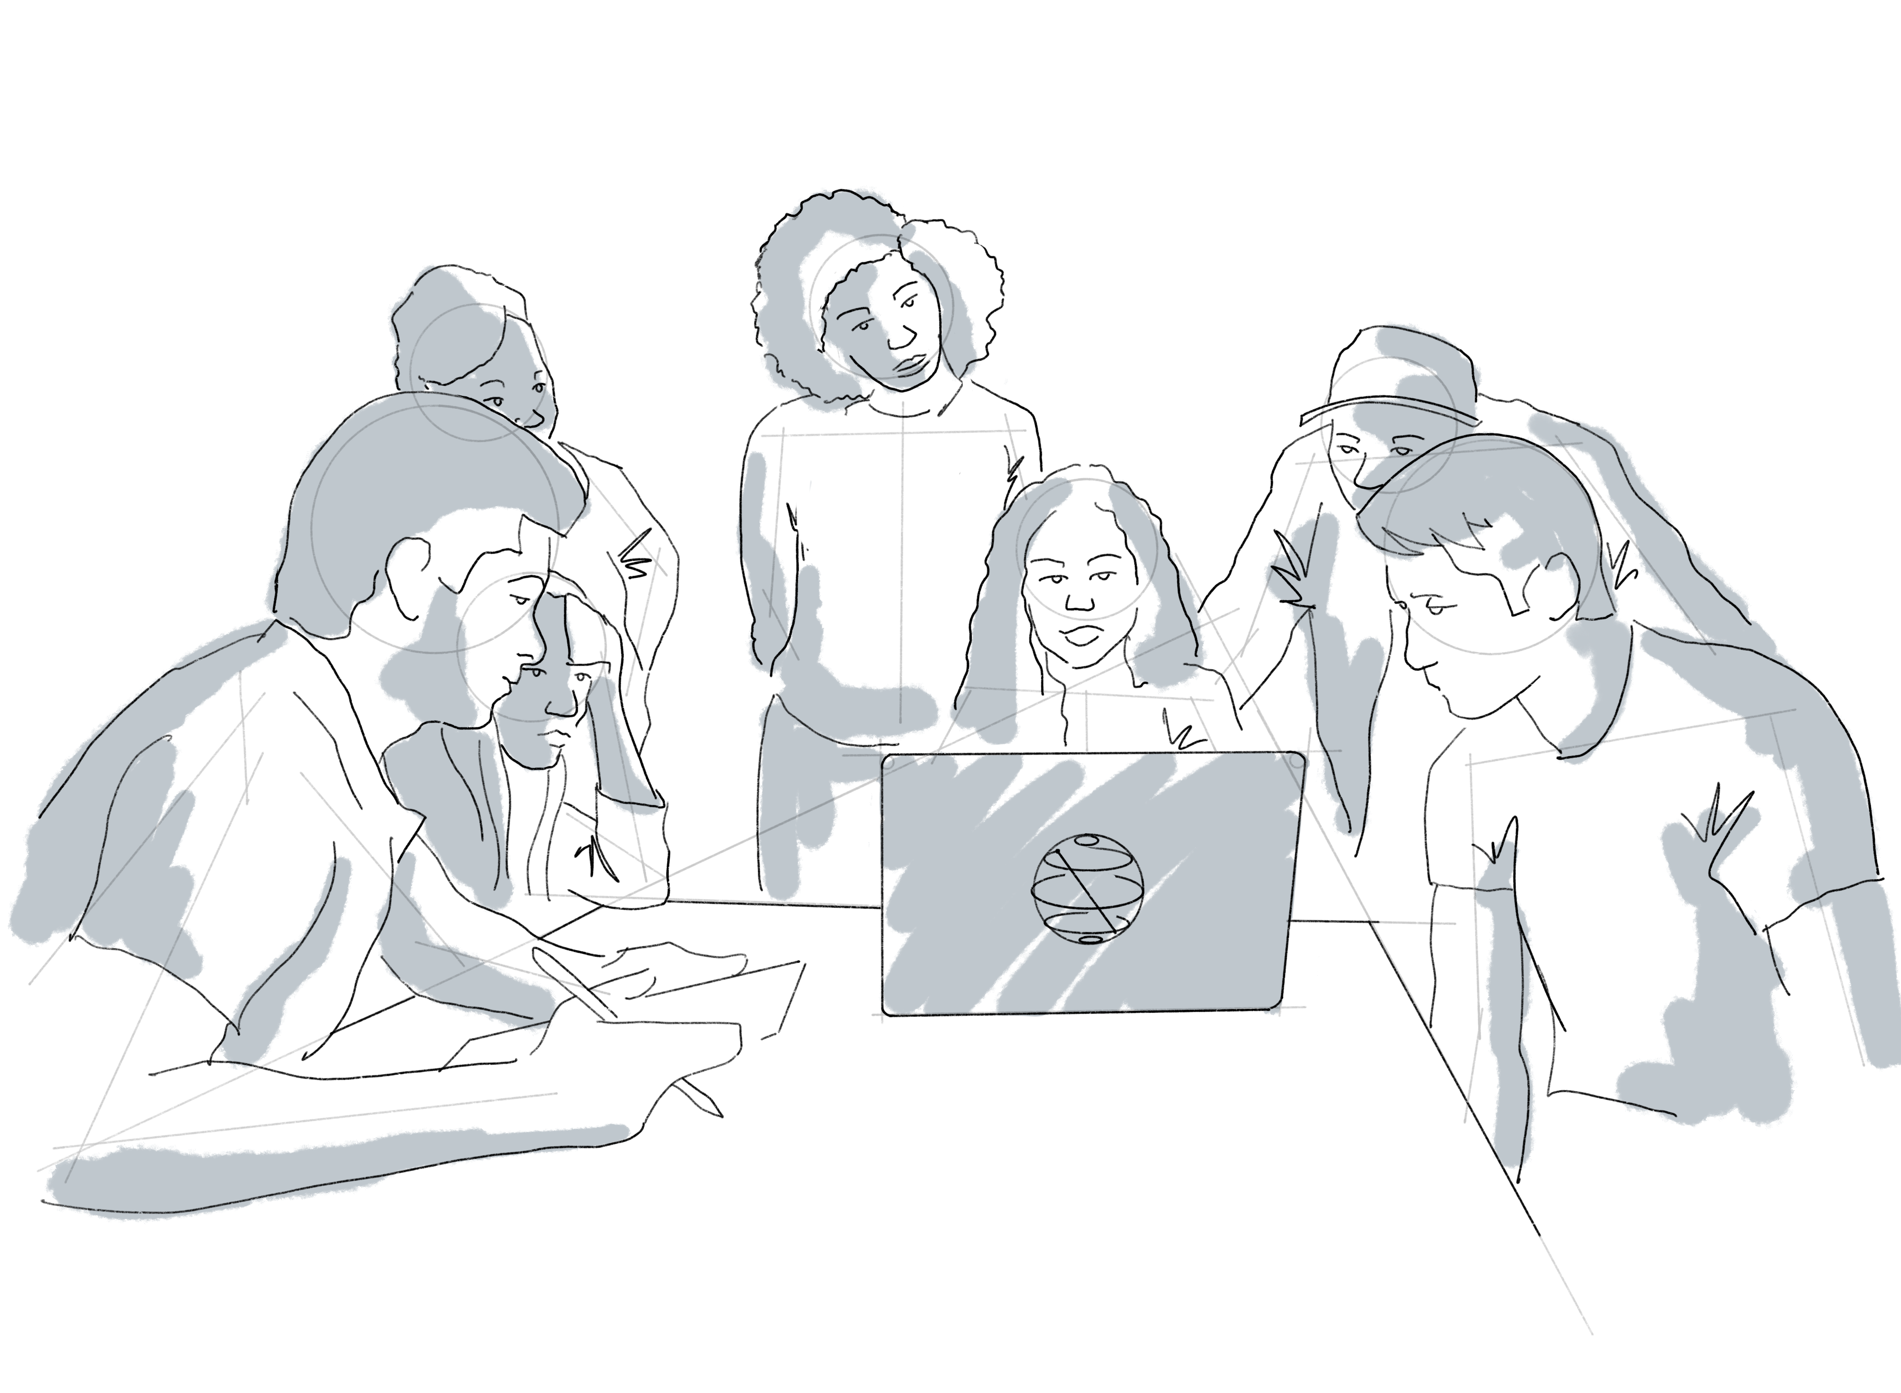
Thank you! Any questions?

Slide 6





Data Re-uploading Classifier (DRC)
An example of 1-qubit DRC circuit.
$$\vec{x}=[x^{1}, x^{2}, …,x^{N}]$$
$$θ_{q,l}^{n}=w_{q,l}^{n}x^{n}+b_{q,l}^{n}$$
$${\vec{θ}}_{q,l}^{n∼n+2}=\left(θ_{q,l}^{n},θ_{q,l}^{n+1},θ_{q,l}^{n+2}\right)$$
1-layer DRC circuit.
Multi-layer DRC circuit.

